Slide 1

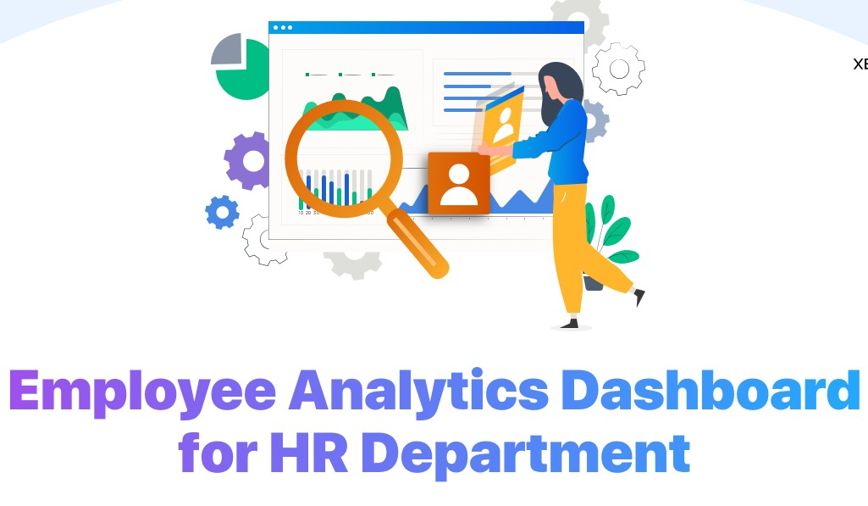
Scifor Technologies
Employee Analytics Dashboard for HR Department
Presented by
Guided by
Shyamashree Ghorai (STB03-T0007)
Miss. Urooj Khan
02 - 2024

Slide 2
Content
Introduction
Data Collection
Data Cleaning and Transformation
Exploratory Data Analysis and Visualization
Conclusion
Employee Analytics Dashboard for HR Department
02 - 2024
2

Slide 3
1. Introduction
Employee Analytics Dashboard for HR Department is a tool that allows HR professionals to analyze and visualize data to organization’s workforce.
HR professional’s can identify insights, patterns, trends and area of improvement within the organization.
The performance and processes of employees are directly observed through the dashboard.
Employee Analytics dashboard for HR Department
02- 2024
3

Slide 4
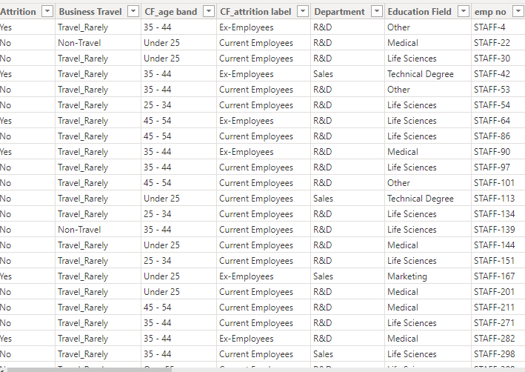
2. Data Collection
The data was collected from one YouTube video.
Dataset consists of 1470 rows and 41 columns.
Employee Analytics Dashboard for HR Department
02 - 2024
4

Slide 5
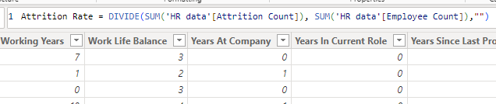
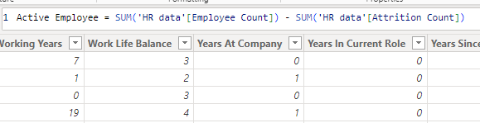
3. Data Cleaning and Transformation
The dataset was imported to power query in Power BI. Data Cleaning and transformation are an important aspect in data analysis process.
I created a new conditional column Attrition Count from Attrition column for further analysis. I set ‘yes’ as 1 and ‘No’ as 0.
I created new measures Active Employee and Attrition Rate.
Employee Analytics Dashboard for HR Department
02 - 2024
5

Slide 6
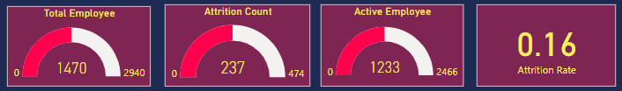
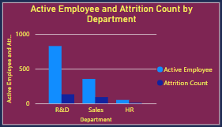
4. Exploratory Data Analysis and Visualization
Firstly, I displayed some Key Performance Indicators (KPIs).
I create a bar chart for finding active employee and attrition count based upon the department. From chart, major part of active employees are from R&D department.
Employee Analytics Dashboard for HR Department
02 - 2024
6

Slide 7
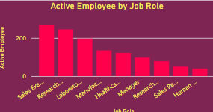
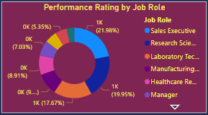
4.Exploratory Data Analysis and Visualization
I create a bar chart for active employee for different job role. Major part of active employee are of job role sales executive, research scientist and laboratory technician.
I create a donut chart for finding performance rating based upon different job role. Sales executive has the highest performance rating.
Employee Analytics Dashboard for HR Department
02 - 2024
7

Slide 8
5. Conclusion
Employee Analytics Dashboard for HR Department is a crucial tool that enables HR professionals to make data-driven decisions.
It involves gathering, analyzing and interpreting data related to employee behavior, performance and engagement to improve organizational performance.
Employee Analytics Dashboard for HR Department
02 - 2024
8

Slide 9


